Slide 1
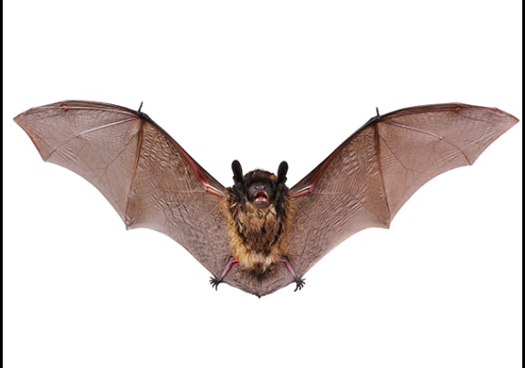
Mrs. PEACOCK’s
OCTOBER 17-20, 2023
WEEKLY SKILLS
Coming up @ Northside
ELA: Stellaluna
PHONICS: long ‘a’
LANGUAGE: shades of meaning
MATH: invertebrates and vertebrates
Oct 16: Parent Conferences
Oct 20: 50th day of school
Oct 20: Spirit Store!
Oct 25: Boosterthon Fun Run Kick Off
Nov 3: Boosterthon Funraiser Fun Run!
Phonics Skill
Vocabulary
Skill of the Week-
Long ’a’- a, ai, ay, ea, eigh, ey
Words to Know-
1. curious- eager to know
2. clutched- tight grip; grasping claw, paw or hand; grasp tightly
3. mango- sour, juicy, oval fruit
4. scent- smell; hunt by using the sense of smell
5. peculiar- strange; odd; unusual
6. survive- live longer; remain alive
7. anxious- worried
8. stutter- repeat the same sound in an effort to speak
agent
pain
day
great
eight
prey
breaking
mailbox
playmate
weighed
they
waiting
train
play
rain
always
were
about
out
Tests/Homework
Reminders
Test- Spelling and Vocabulary Friday
Homework- reading, math, and math facts
Students will not be allowed to go on the filed trip if they have
more than 19 tardies/early dismissals or 9 unexcused absences

